Slide 1
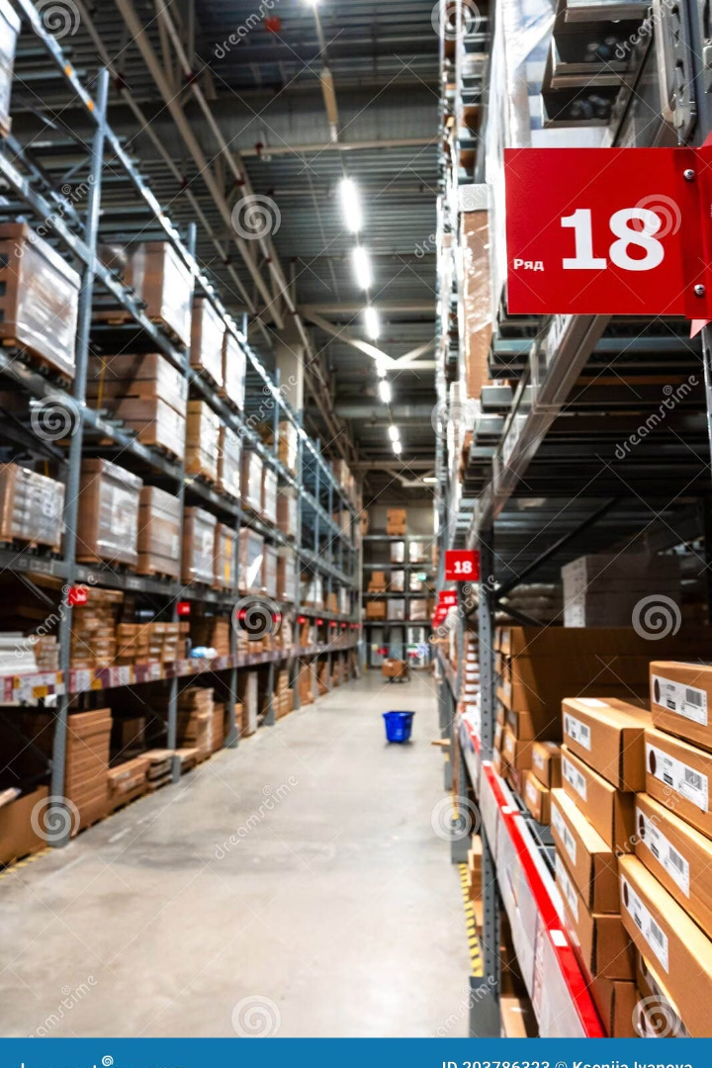
Inventory Management System.
This presentation provides an overview of our Inventory Management System, including its core features, database design, and user interface components.

Slide 2

Group Members
233518(Tooba Ghaffar)
233520(Komal Naz)
233582(Amna Sajjad)

Slide 3

Core Features of IMS
1
Inventory Tracking
2
Product Management
3
Order Management
4
Stock Control
6
Security & Compliance
5
Reports & Analytics
7
User Management &
Audit logs
8
Integration & Settings

Slide 4

Inventory Tracking Features
Real-Time Stock Updates
Automatic updates on sales and purchases.
Multi-Location Support
Track inventory across warehouses or stores.
Batch and Serial Tracking
Manage products by batch, lot, or serial numbers.
Stock Movement History
Keep a log of all inventory movements (inflow, outflow, adjustments).

Slide 5

Product Management Features
Product Registration
Barcode Integration
Add new products with details.
Generate and scan barcodes.
Categorization
Organize products into categories.

Slide 6




Order Management Features
Purchase Orders
Sales Orders
Reorder Point Alerts
Create, track, and manage orders.
Process customer orders.
Get alerts when stock is low.

Slide 7

Stock Control Features
1
Stock In/Out Transactions
Record purchases and sales to update inventory levels.
2
Stock Transfers
Move stock between locations.
3
Stock Adjustments
Adjust stock levels due to shrinkage.

Slide 8
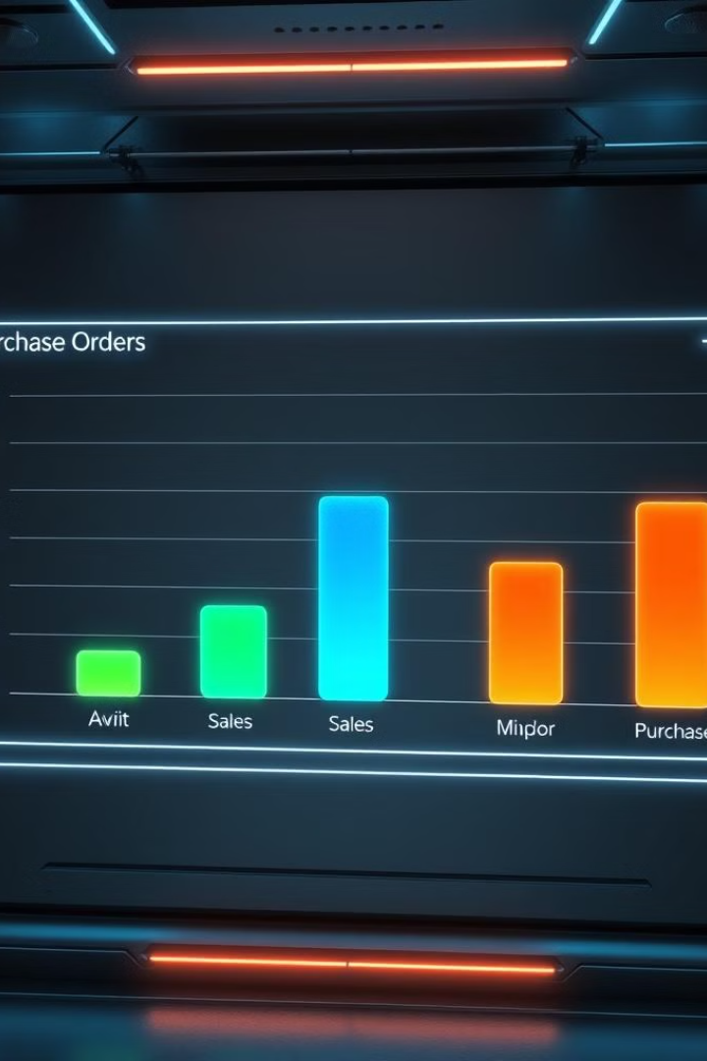
Reports & Analytics
100%
100K
Inventory Valuation
Stock Movement Reports
Get reports on the total value.
Track stock inflow, outflow.
1M
Sales & Purchase Reports
View sales trends and supplier performance.

Slide 9



User Management & Audit Logs
Role-Based Access Control: Assign user roles (Admin, Manager, Staff)
with specific permissions.
1
2
User Authentication: Secure login with password encryption.
3
Audit Logs:Track user actions and maintain
accountability.

Slide 10

Security & Compliance
1
Data Encryption: Protect sensitive data during storage and transmission.
2
Backup & Recovery: Ensure automated backups and recovery.
3
Compliance Support: Adhere to industry
standards and regulations .

Slide 11



Integration & Automation
Accounting Integration
E-commerce Integration
Email & Notifications
Sync data with QuickBooks,Xero.
Integrate with Shopify.
Send updates and alerts for important
system changes (e.g., low stock levels,
order updates).

Slide 12
Database Design Overview
Products Table: Stores product information (ID, SKU, name, price, stock level).
Suppliers Table: Contains supplier details (ID, name, contact information).
Purchase Orders Table: Tracks orders from suppliers (ID, status, total amount).
Sales Orders Table: Stores customer orders (ID, status, total amount).
Stock Movements Table: Logs stock inflows ,outflows, and adjustments.
Audit Logs Table: Tracks user actions for security purposes.

Slide 13
User Interface Components (UI)
Dashboard: Real-time stock levels, alerts, and sales summaries.
Product Management: Add/edit/delete products and barcode generation.
Inventory Tracking: View stock levels, batch tracking, stock movements.
Purchase/Sales Order Management: Create and manage orders and suppliers.
Reports: Generate real-time reports on stock, sales, and purchase history.
User Management: Administer roles, permissions, and user activity logs.

Slide 14

Conclusion
Key Benefits of IMS:
Streamlined inventory tracking and order management.
Increased accuracy and efficiency with barcode scanning and real-time updates.
Data-driven insights through advanced reporting and analytics.
Enhanced security and compliance for sensitive data.

Slide 15


Slide 16


